Slide 1
Using cppcheck & flawfinder for C & C++ Static Analysis

Slide 2
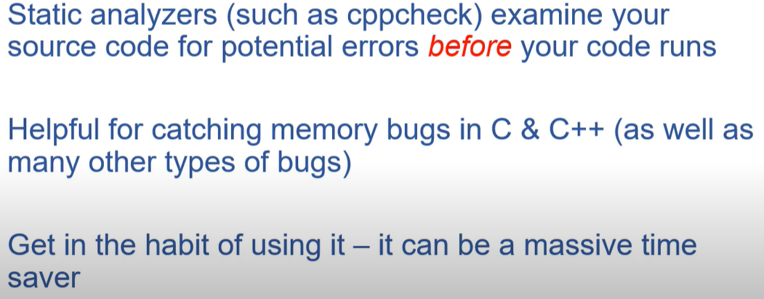
Static code analysis

Slide 3
Commonly-occuring classes of memory-related bugs in C/C++.
Following are the most frequently-occuring memory errors:
Memory Leaks: memory is allocated but not deallocated, causing the program to consume more and more memory over time
Dangling Pointers: a pointer to a memory location that has already been freed explicitly or by a garbage collector
Buffer Overflows: write to a memory buffer beyond its allocated bounds, causing the program to crash or behave unexpectedly
Use After Free: memory access that has already been freed, causing the program to crash or corrupt memory
Invalid Free: attempt to free memory that has not been dynamically allocated
Double Free: program attempts to free memory that has already been freed
Notes:
https://github.com/binjamil/alzheimers

Slide 4
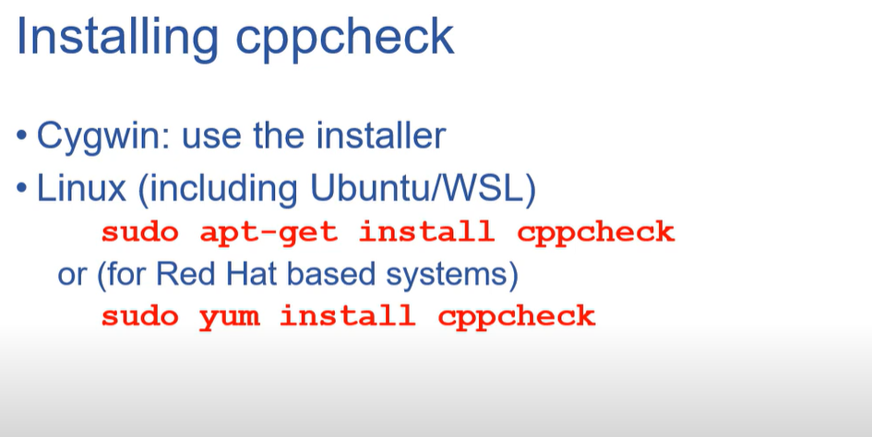

Slide 5
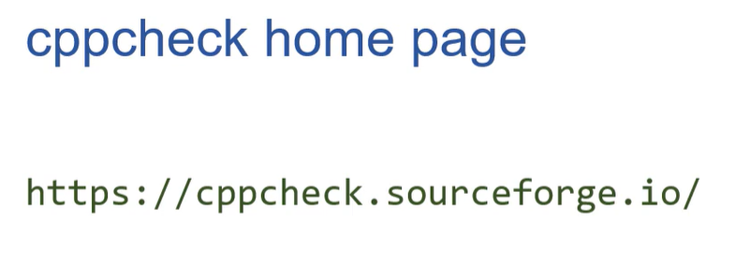

Slide 6
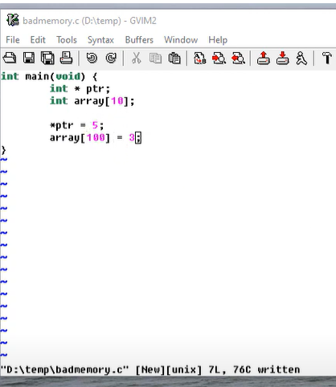
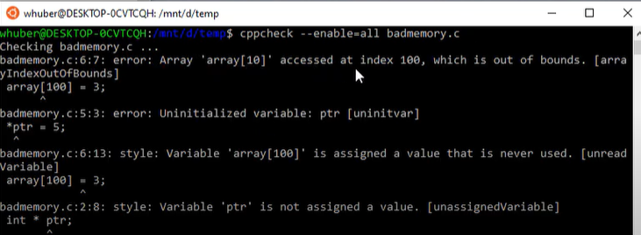

Slide 7
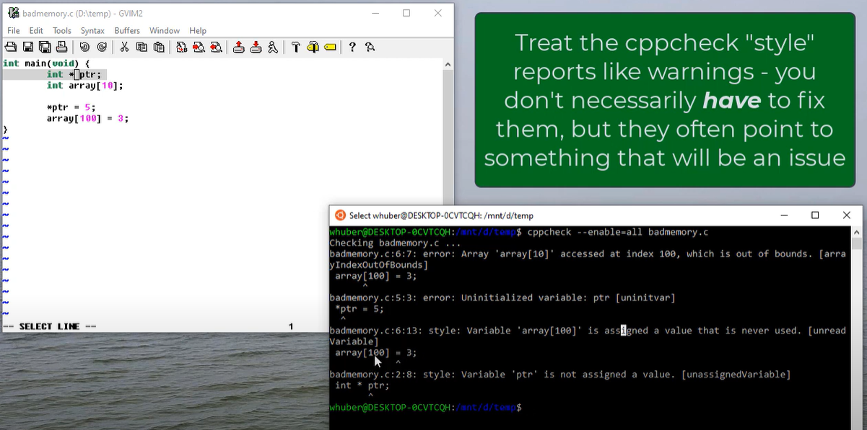

Slide 8
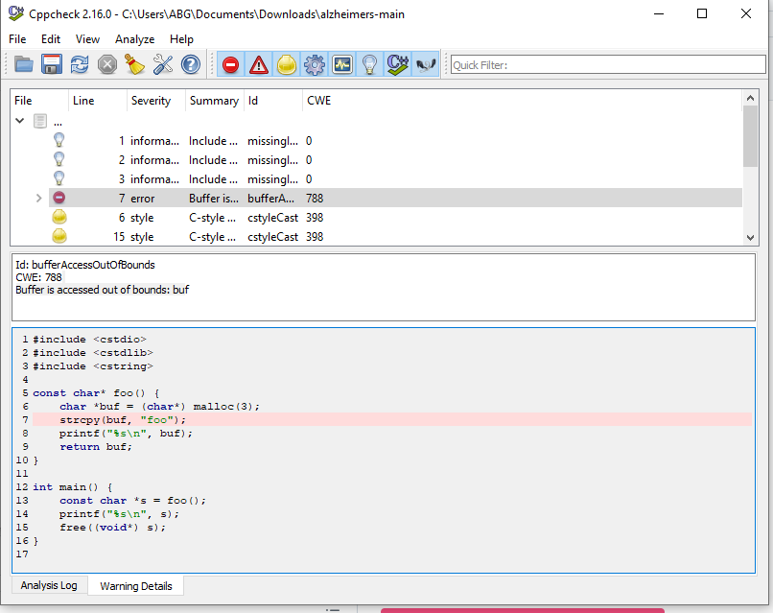

Slide 9
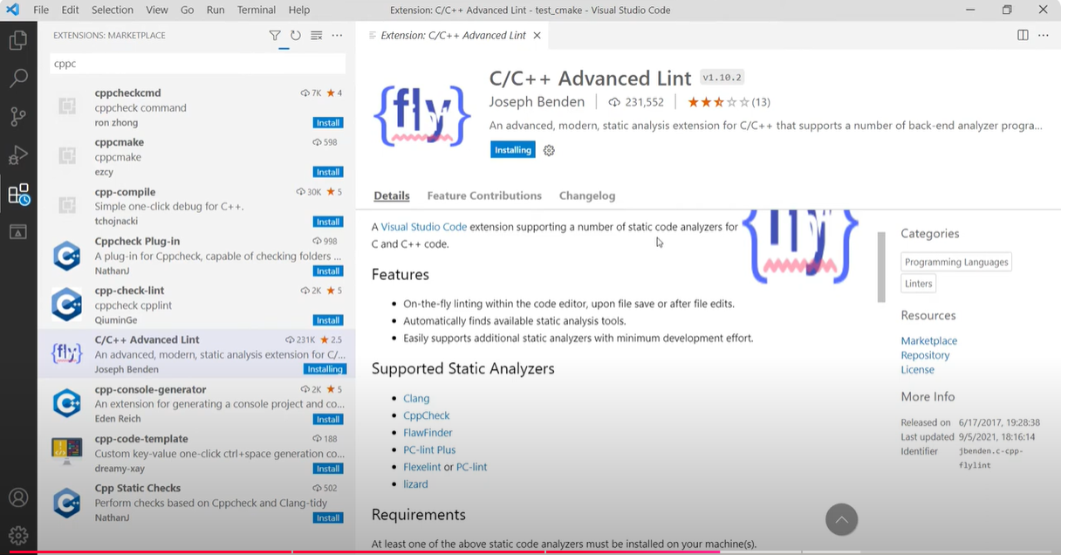

Slide 10
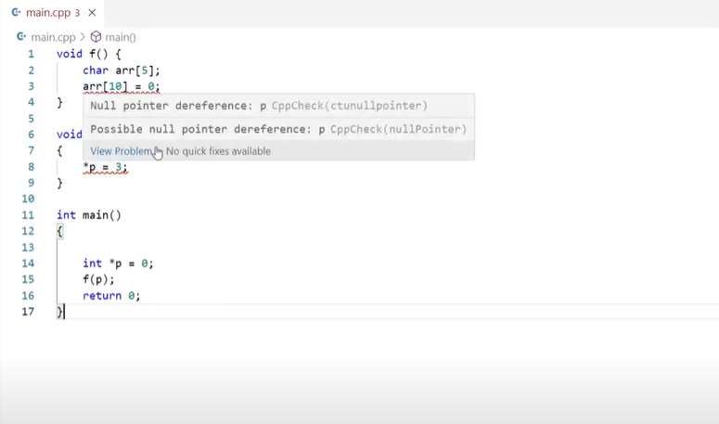

Slide 11
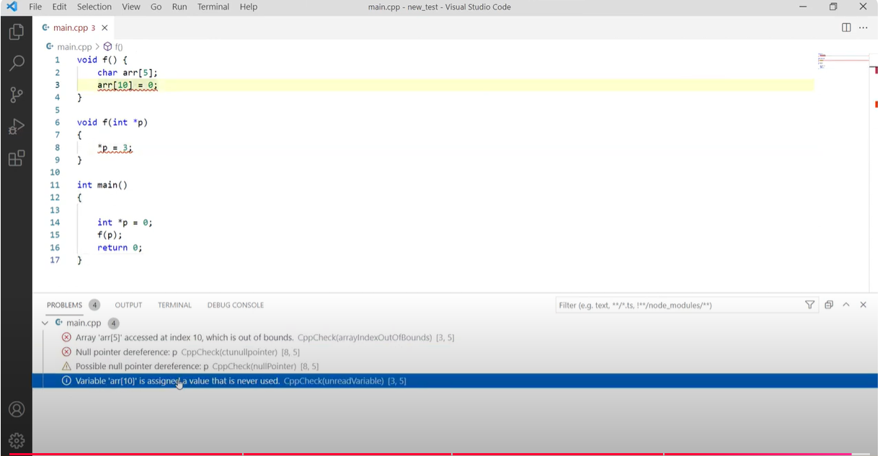

Slide 12
Flawfinder

Slide 13
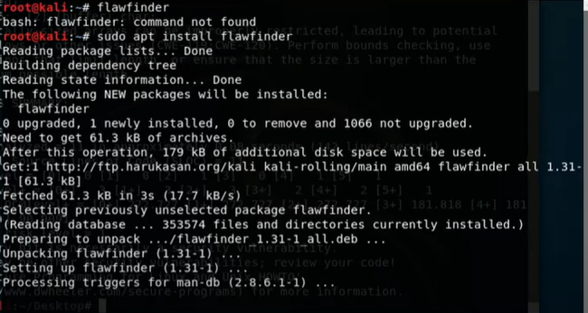

Slide 14
